Slide 1

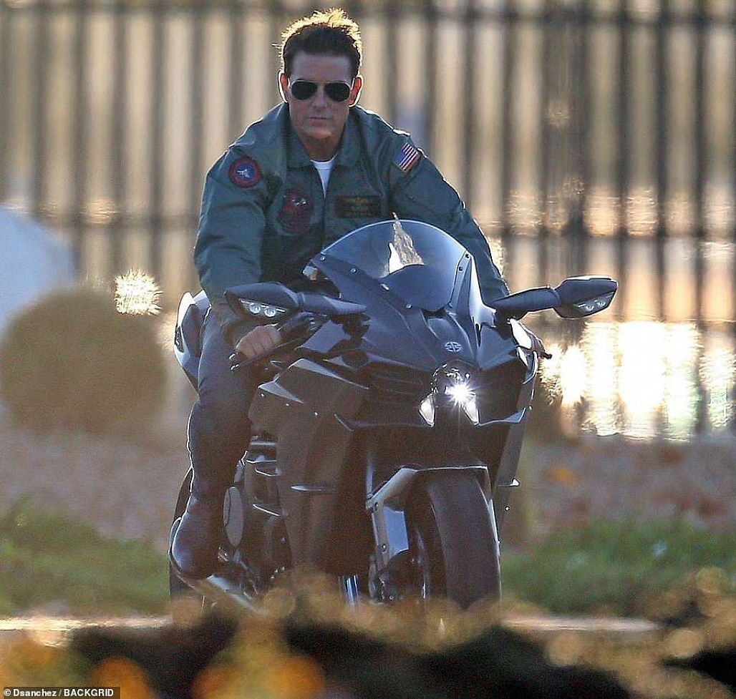
Project on: Road Safety Detection For Two Wheelers
B .Tech Computer science and business systems

Slide 2
Our team
Sayantan dey sarkar roll- 1811100002048
Aniket Saha roll- 1811100002049
Mentor : Professor Sudhindhu Bikash MAndal

Slide 3
Problem vs. Solution
01
Project
02
Table of contents
Hurdles
03
Progress so Far…
04

Slide 4
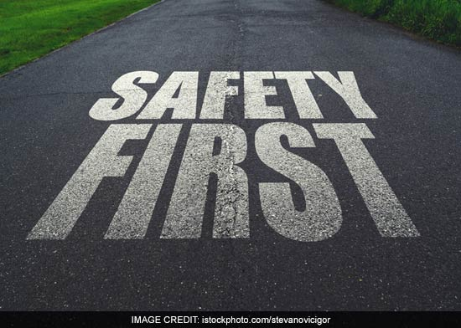
Introduction
Road safety problems are local, meaning that the specific characteristics of a problem are often unique in each community.

Slide 5
Problem
Most people riding two wheelers are very ignorant about minimum riding safety

Slide 6
Solution
The project here is to take on them with the help of very effective high speed camera network, the project will be system upgrade to it this will detect people not wearing helmets riding their two wheelers

Slide 7
Literature Survey
At present, previous studies and works of safety are done on helmets detection can be divided into three parts, sensor-based detection, machine based detection, and deep learning-based detection.
Source: shorturl.at/izDHJ

Slide 8
Using the mechanicals eyes
The Traffic surveillance system has modernized a lot in most of the cities
Of India with network of CCTV now its time to catch not only rash driving
license plates of 4+ wheelers but also Safety ignoring motor bike riders by
baking some efficient algorithm into the system.

Slide 9
Our plan
Detecting the motor-bike riders wearing helmet and non-wearers too “Precisely”
At daylight

Slide 10
The algo in use: YoloV5
YOLO an acronym for 'You only look once'

Slide 11
Concisely how it works?: YoloV5

Slide 12
there are hurdles
The main challenge of working on this problem is the unavailability of dataset to train

Slide 13
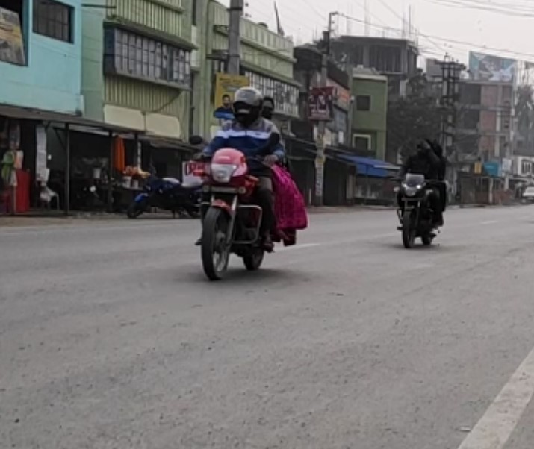
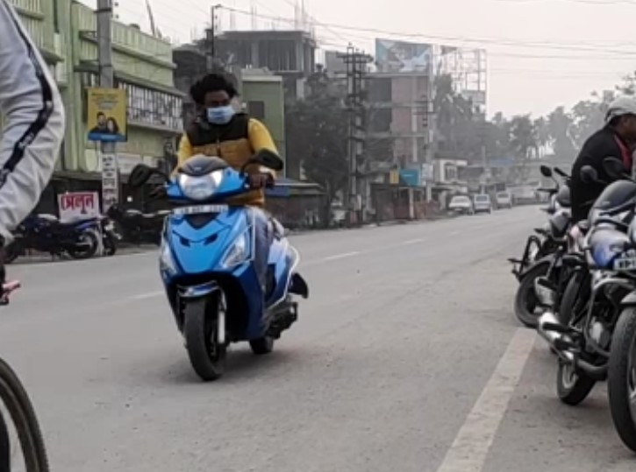
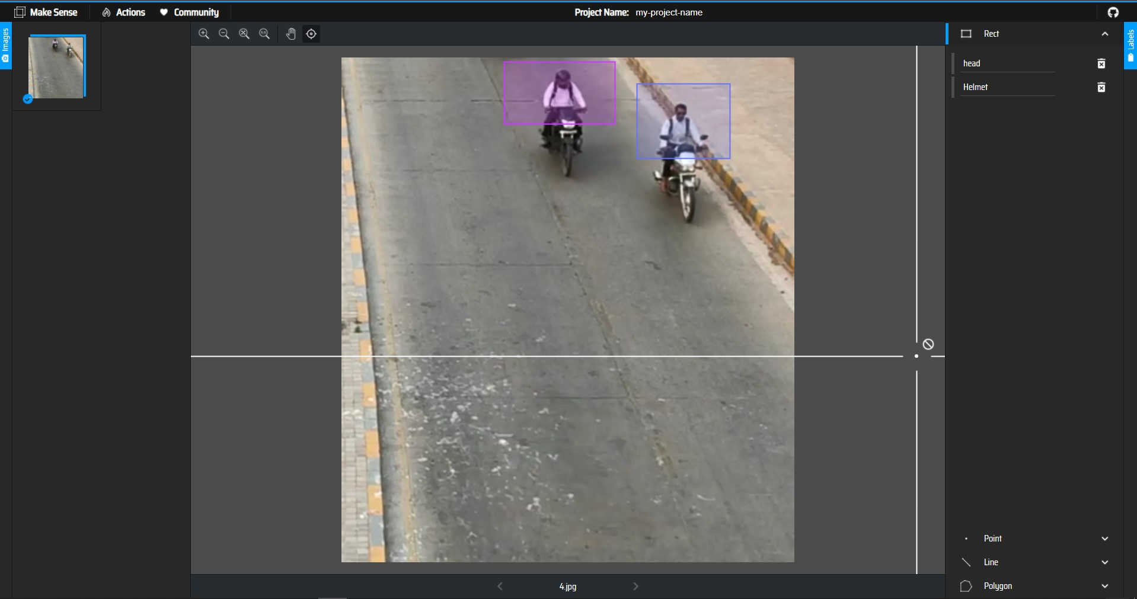
Dataset & preprocessing
Dataset having videos such as these.
Preprocessing using online labeling service as makesense.ai.

Slide 14
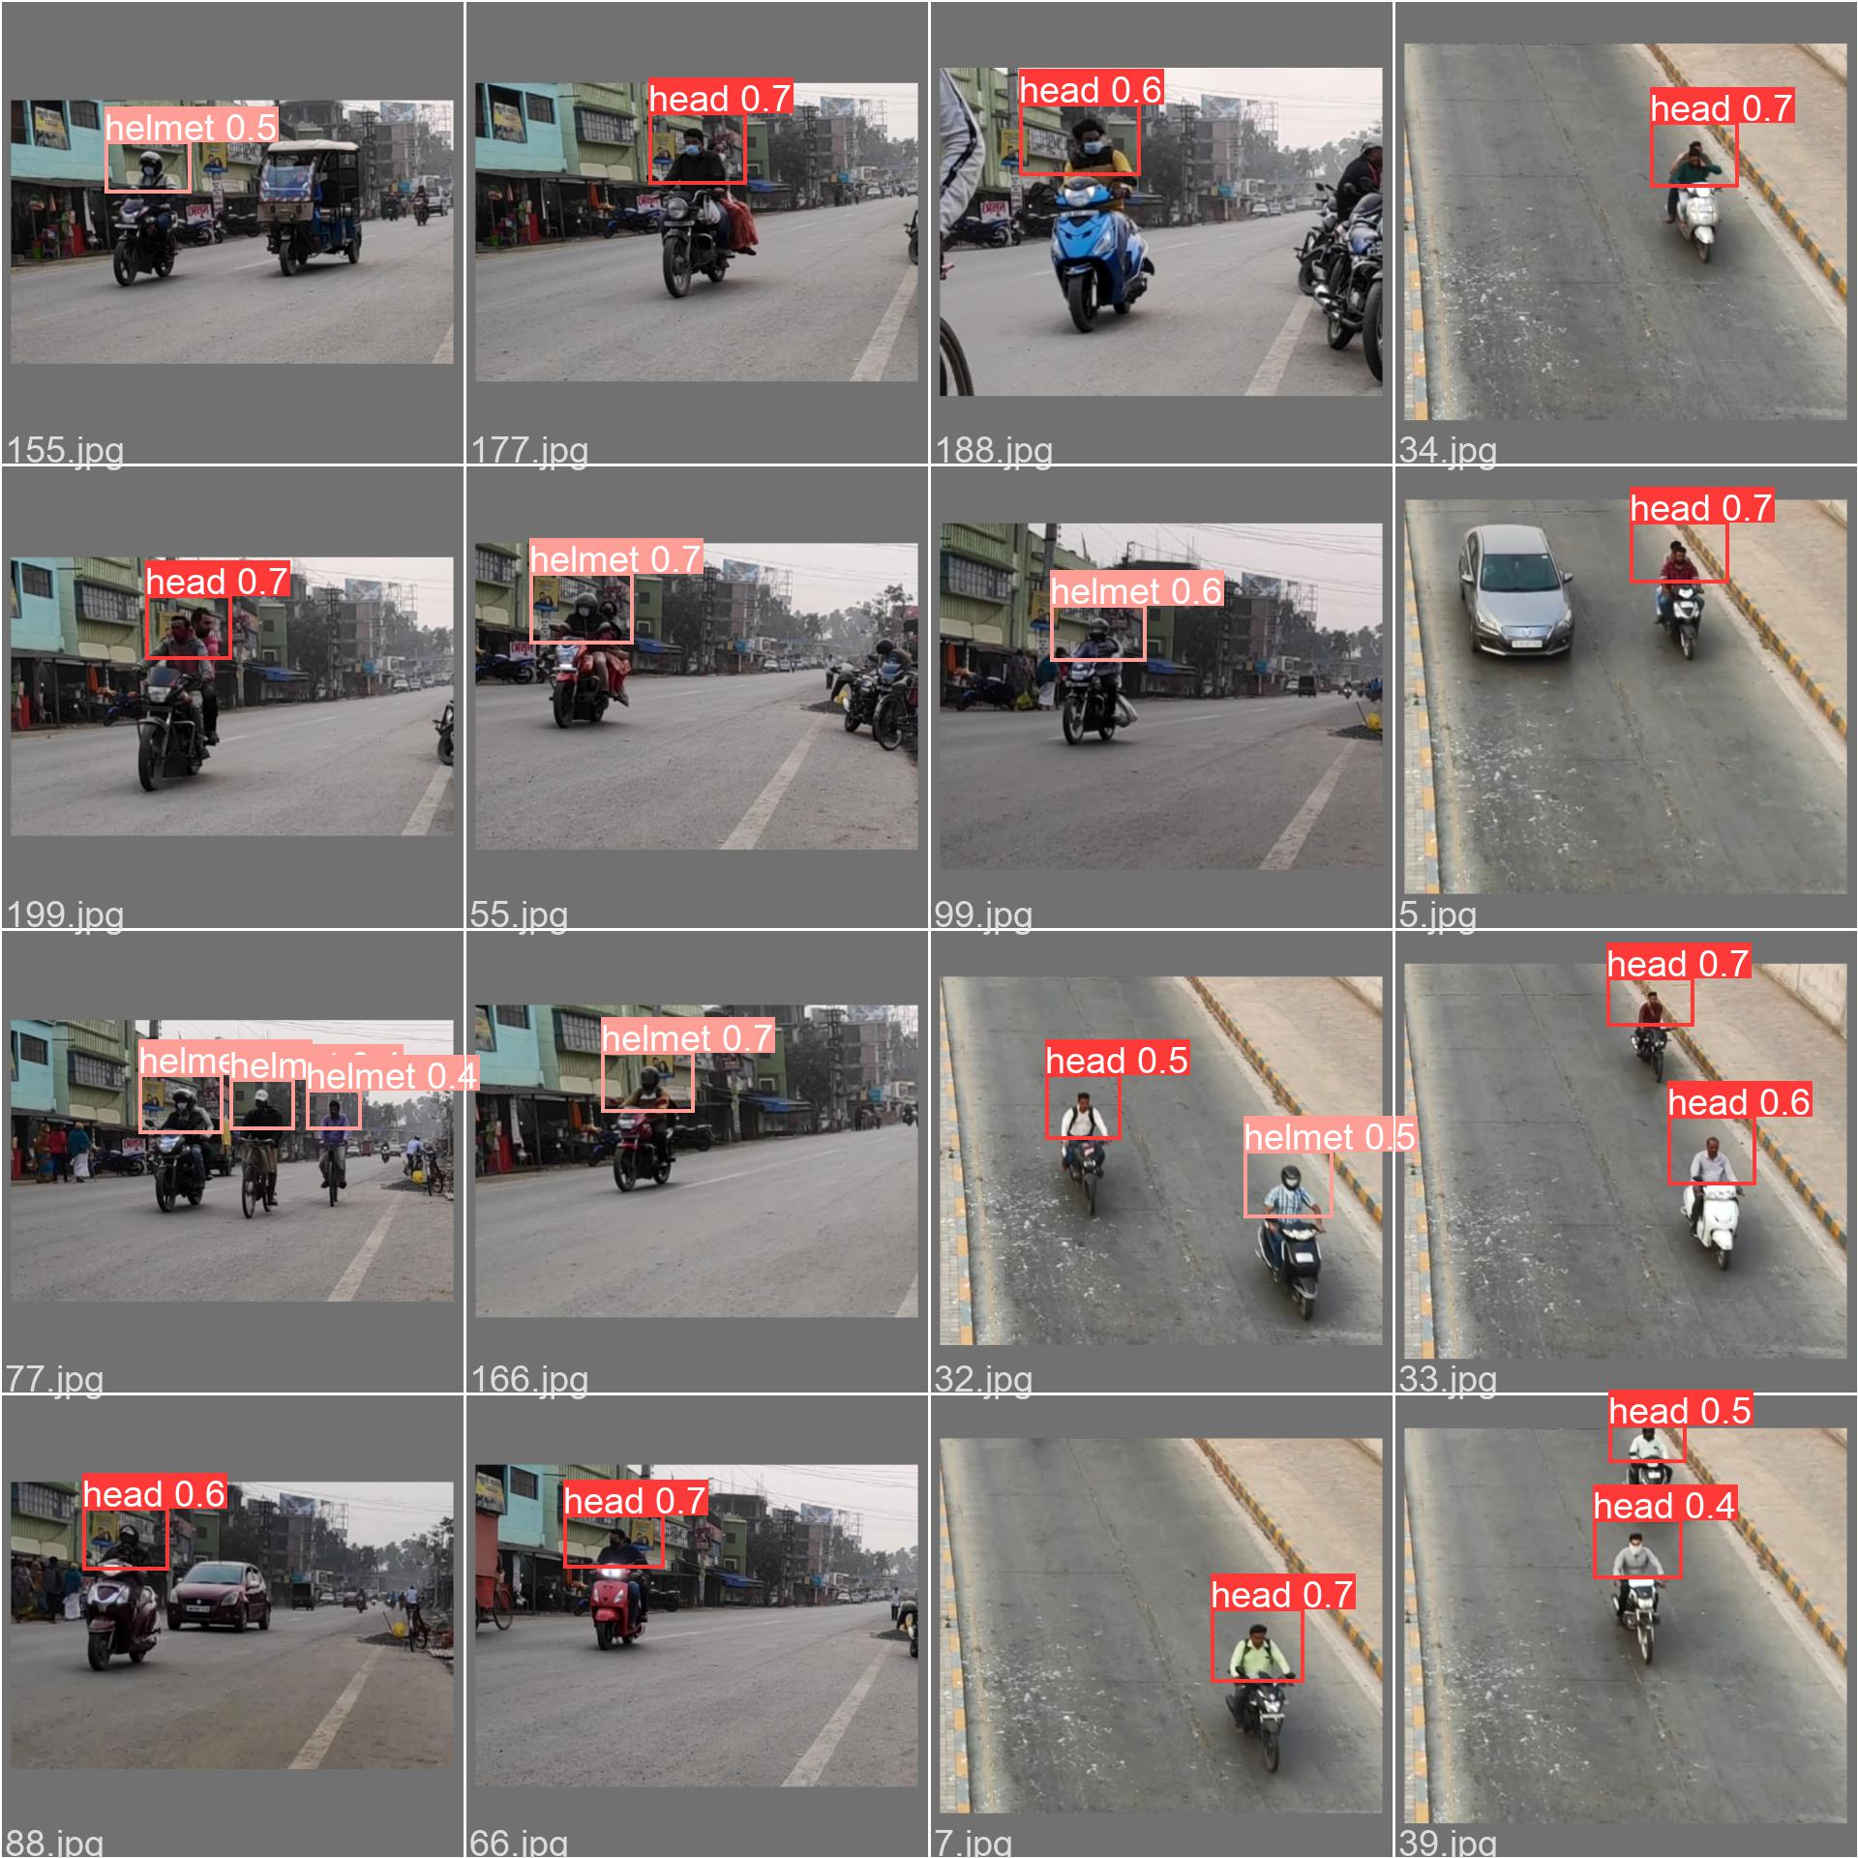
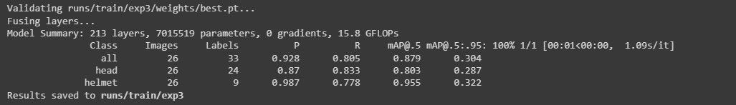
How its doing?
.
Doing pretty well , predicting and detecting.
And the accuracy is respectable too.
87.9% precisely

Slide 15
Future scopes?
.
There are many such modifications and enhancement we would like to add to the current working model :
Detect whether it is a motor bike or cycle.
Detect whether a person is walking on road.
Capture the image of license plates of the rule breakers.

Slide 16
Thanks
To our mentor and the teachers present.

